Slide 1
HAND GESTURE RECOGNITION
Group 7
Ho Cong Duy – 1751060
Nguyen Phuc Khang – 1751074
Nguyen Dinh Huan - 1751069

Slide 2
PROBLEM
MOTIVATION
RELATED WORKS
OBJECTIVE
METHOD & DATA SET
RESULT
OPEN PROBLEM & FUTURE WORK

Slide 3
input
output
One
C
Palm
OK
Thump up
Pointing up
Hand Gesture Image

Slide 4
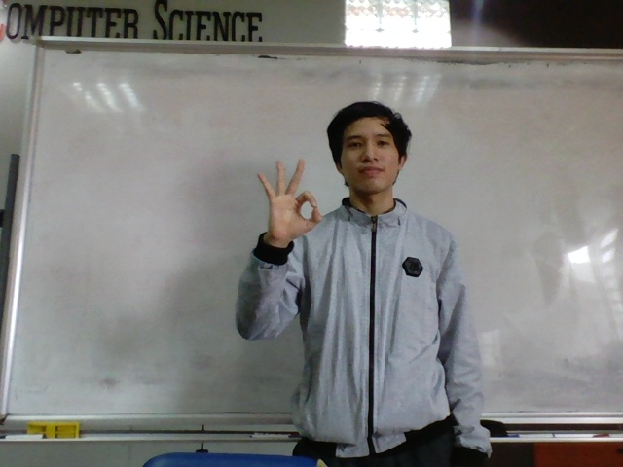
input
output
One
C
Palm
Hand Gesture Image
OK
Thump up
Pointing up

Slide 5
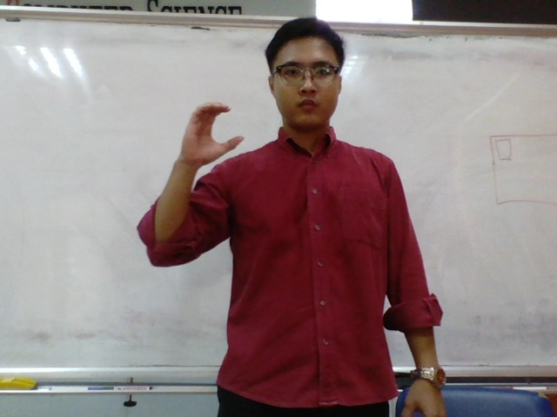
input
output
One
C
Palm
Hand Gesture Image
OK
Thump up
Pointing up

Slide 6
PROBLEM
MOTIVATION
RELATED WORKS
OBJECTIVE
METHOD & DATA SET
RESULT
OPEN PROBLEM & FUTURE WORK

Slide 7
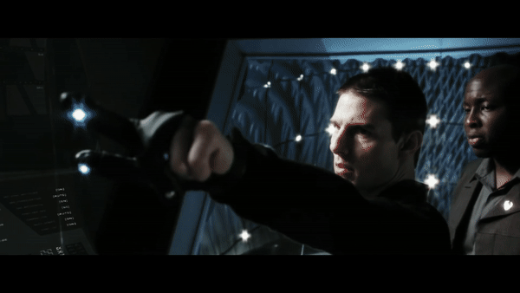
A Gesture-based user interface
Minority Report (2002)

Slide 8

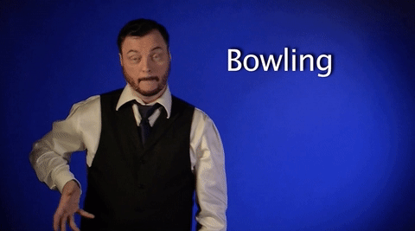


Sign Language translator

Slide 9
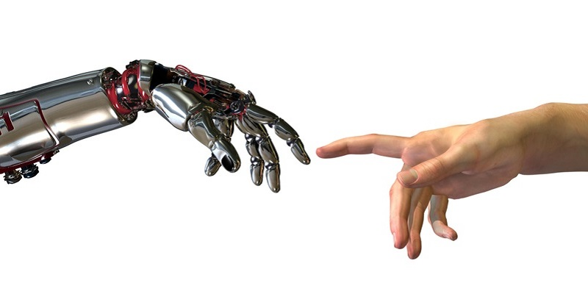
Enhance HCI

Slide 10
PROBLEM
MOTIVATION
RELATED WORKS
OBJECTIVE
METHOD & DATA SET
RESULT
OPEN PROBLEM & FUTURE WORK

Slide 11
Real-Time Hand Gesture Recognition Using
Finger Segmentation
Zhi-hua Chen, Jung-Tae Kim, Jianning Liang, Jing Zhang, Yu-Bo Yuan
24 April 2014
HAND DETECTION
PALM & FINGERS SEGMENTATION
FINGERS RECOGNITION
HAND GESTURES RECOGNITION

Slide 12
Real-Time Hand Gesture Recognition Using
Finger Segmentation
Zhi-hua Chen, Jung-Tae Kim, Jianning Liang, Jing Zhang, Yu-Bo Yuan
24 April 2014
OUTPERFORM
Highly
State-of-art FEMD (2013)
by
DEPEND
3%
In 10 X 10 X10
Cases of Hand Gesture Images data Set
On
Result from Hand Detection

Slide 13
PROBLEM
MOTIVATION
RELATED WORKS
OBJECTIVES
METHOD & DATA SET
RESULT
OPEN PROBLEM & FUTURE WORK

Slide 14
IMPROVE
CURRENT METHOD
INTRODUCE
NEW METHOD
EXTEND
LIST OF GESTURES
ASSESS
OTHER PEOPLE’s WORKS

Slide 15
PROBLEM
MOTIVATION
RELATED WORKS
OBJECTIVE
METHOD & DATA SET
RESULT
OPEN PROBLEM & FUTURE WORK

Slide 16
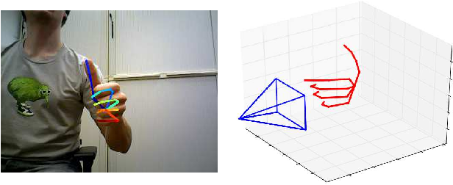
Christian Zimmermann, Thomas Brox
University of Freiburg
15 Oct 2017
LEARNING TO ESTIMATE 3D HAND POSE FROM SINGLE RGB IMAGE
GROUND WORK

Slide 17


CLASSIFICATION OF HAND GESTURE POSE USING TENSORFLOW
PRASAD PAI
FEB 15, 2018
Y MEDIA INNOVATION LAB

Slide 18
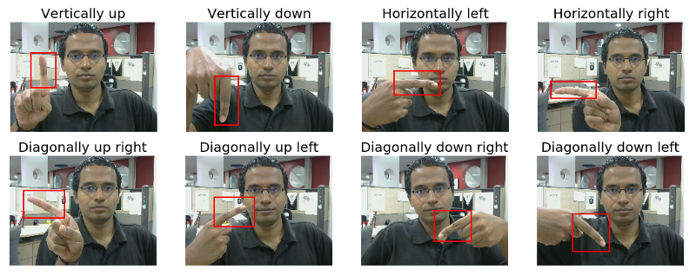
3
Directional Orientation and Curls of Fingers
METHODS

Slide 19
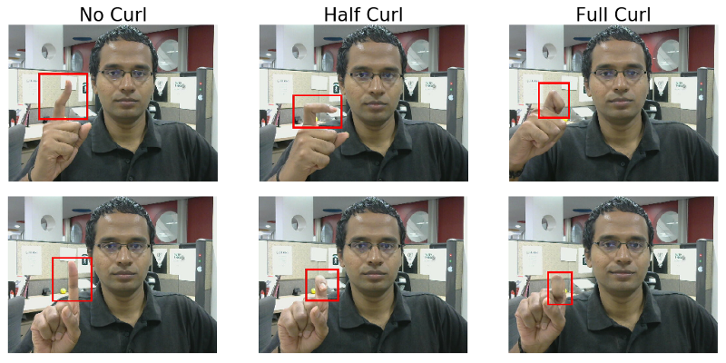
3
Directional Orientation and Curls of Fingers
METHODS

Slide 20
3
GEOMETRIC
NEURAL NETWORK
METHODS

Slide 21
3
GEOMETRIC
NEURAL NETWORK
SUPPORT VECTOR MACHINE
METHODS

Slide 22


DATA SET
IMAGES / GESTURE
GESTURE NUM
TOTAL
Real – time hand gesture recognition using Finger Segmentation (2014)
100 (640 x 480)
13
3
4
1300
Robust part-based hand
gesture recognition using kinect sensor (2013)
100
10
10
1000
RENDERED HANDPOSE
41258 Training + 2728 Testing
GROUP 4
1200
44
1
0
52800
OUR GROUP (7)
600
10
3
0
6000

Slide 23
PROBLEM
MOTIVATION
RELATED WORKS
OBJECTIVE
METHOD & DATA SET
RESULT
OPEN PROBLEM & FUTURE WORK

Slide 25
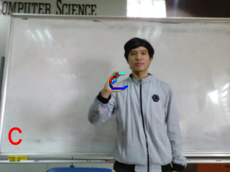
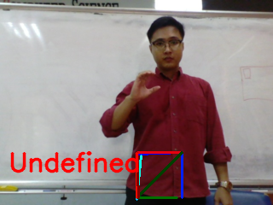
REMARKS ON ACCURACY
SKIN COLOR

Slide 26
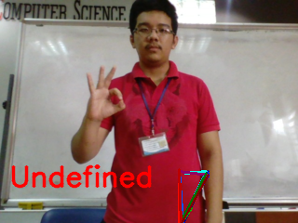
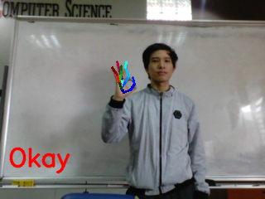
REMARKS ON ACCURACY
SKIN COLOR
BACKGROUND COLOR

Slide 27
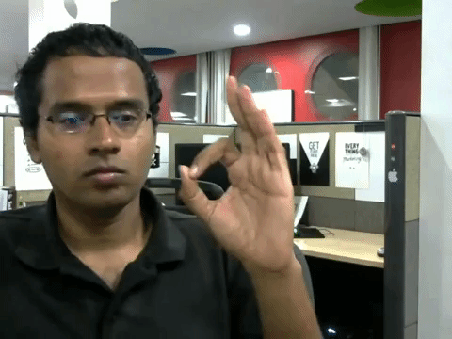
REMARKS ON ACCURACY
SKIN COLOR
BACKGROUND COLOR
DISTANCE

Slide 28
PROBLEM
MOTIVATION
RELATED WORKS
OBJECTIVE
METHOD & DATA SET
RESULT
OPEN PROBLEM & FUTURE WORK

Slide 30

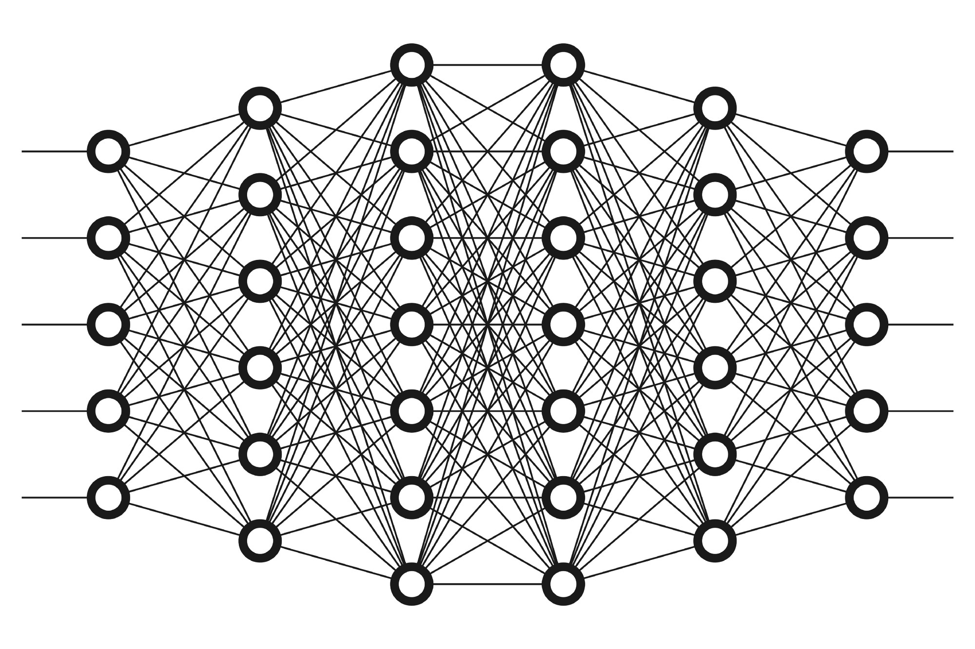
HAND DETECTION
CLASSIFICATION
HAND GESTURE RECOGNITION
NEW METHOD
REAL - TIME
MULTI-PERSON
KEYPOINT
CNN
DETECTION LIB
FOR BODY, FACE, HAND
RCNN

Slide 31
INPUT FROM OPENPOSE ?
BETTER ACCURACY
GOOD CLASSIFER
NO DISTANCE PROBLEM
EFFICIENT
NO SKIN COLOR PROBLEM
FAST

Slide 32
THANK YOU.

